Slide 1



Payarc
Payment
Solutions
Terminal Solutions Gateway Solutions

Slide 2


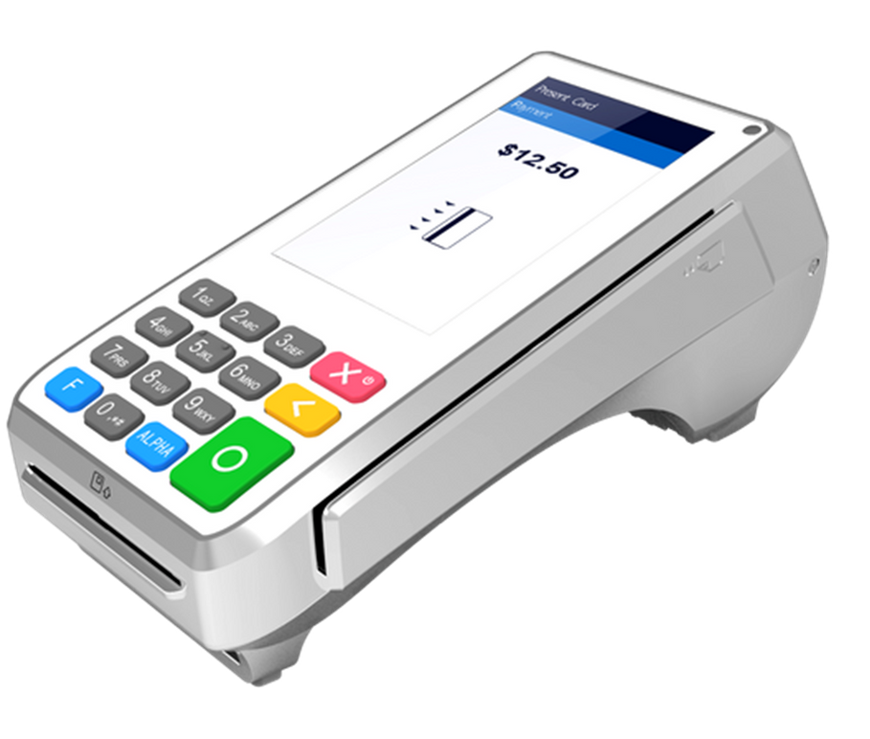

PAX A80
Payarc App
Standalone terminal / 4” Touchscreen Wi-Fi/Ethernet connectivity
Magstripe, EMV & Contactless capability
Can connect to an external pin-pad
Internal Printer
Cash Discount on both Credit/Debit
Can do tips at the time of sale only
Cannot enable tax feature
Cannot enable clerk, order, invoice prompts, etc Does not support Auth & Capture

Slide 3
PAX A80
Sierra/Transit App
Standalone terminal / 4” Touchscreen Wi-Fi/Ethernet connectivity
Magstripe, EMV & Contactless capability
Can connect to an external pin-pad
Internal Printer
Cash Discount on Credit cards only
Can do tips at the time and after the sale Can enable clerk, order, invoice prompts, etc Cannot enable tax feature
Does not support Auth & Capture

Slide 4
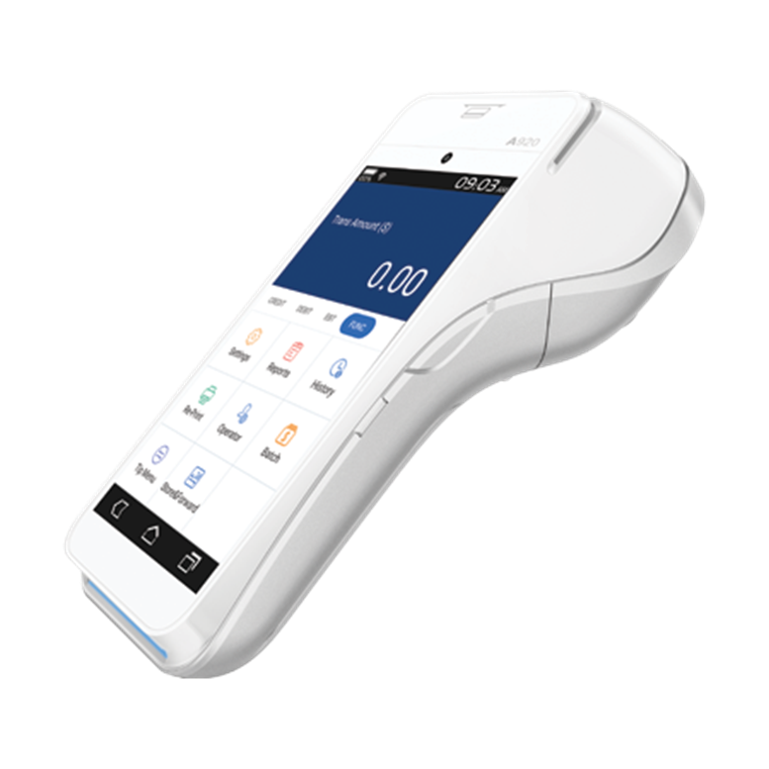
PAX A920
Payarc App
Wi-Fi/5G Connectivity - Wireless
Battery powered / 5” Touchscreen Magstripe, EMV & Contactless capability Internal Printer
Cash Discount on both Credit/Debit
Can do tips at the time of sale only Cannot enable tax feature
Cannot enable clerk, order,
invoice prompts, etc
Does not support Auth & Capture

Slide 5
PAX A920
Sierra/Transit App
Wi-Fi/5G Connectivity - Wireless
Battery powered / 5” Touchscreen Magstripe, EMV & Contactless capability Internal Printer
Cash Discount on Credit cards only
Can do tips at the time and after the sale Can enable clerk, order, & invoice prompts Cannot enable tax feature
Does not support Auth & Capture

Slide 6
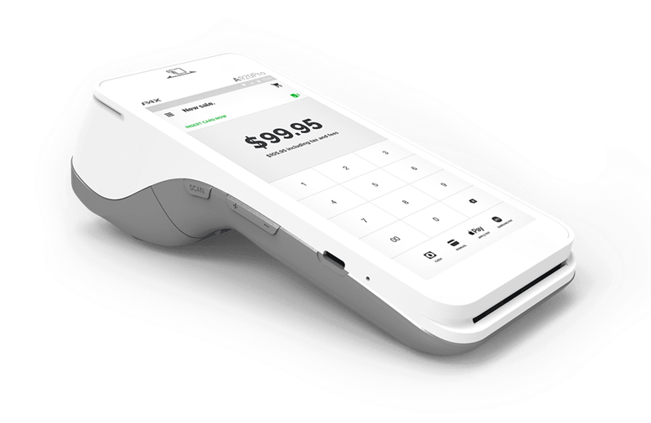
PAX A920 PRO
Wi-Fi/5G Connectivity - Wireless
Battery powered / 5.5” Touchscreen Magstripe, EMV & Contactless capability Internal Printer
Similar features as the A920, only difference is a bigger display çand battery life.

Slide 7
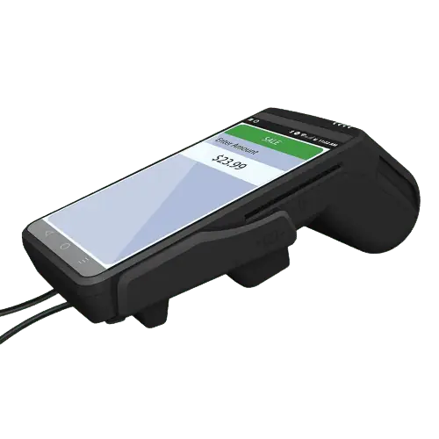
Dejavoo QD4
Standalone terminal / 5.5” Touchscreen Wi-Fi/Ethernet connectivity
Magstripe, EMV & Contactless capability Can connect to an external pin-pad Internal Printer
Cash Discount Capability
Can do tips
Auto tax capability
Can enable clerk, order, & invoice prompts Can do Auth & Capture

Slide 8
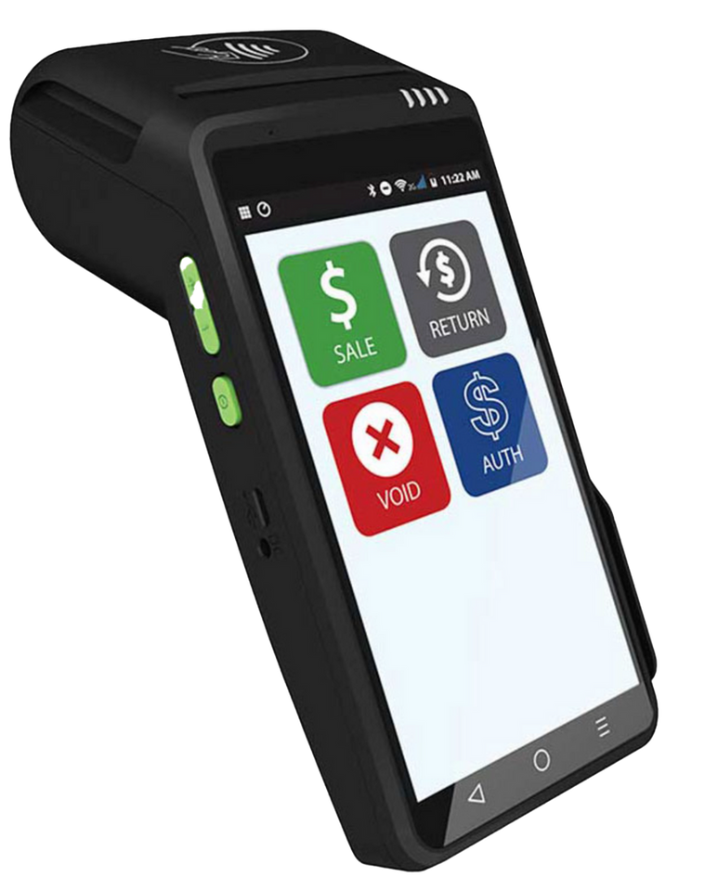
Dejavoo QD2
Wi-Fi/5G Connectivity - Wireless
Battery powered / 5.5” Touchscreen Magstripe, EMV & Contactless capability Internal Printer
Cash Discount Capability
Can do tips
Auto tax capability
Can enable clerk, order, & invoice prompts Can do Auth & Capture

Slide 9
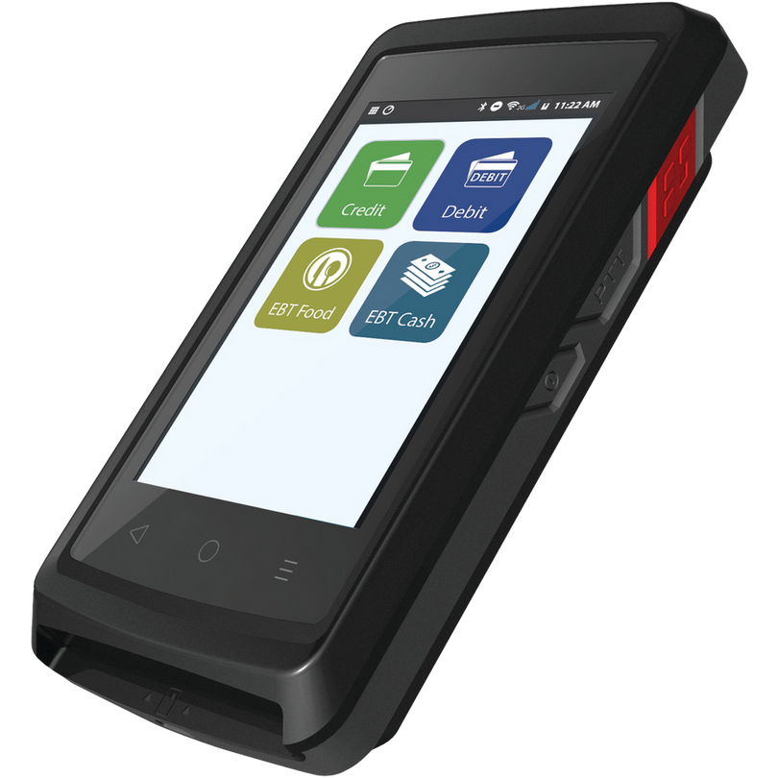
Dejavoo QD3
Wi-Fi/5G Connectivity - Wireless
Battery powered / 4” Touchscreen Magstripe, EMV & Contactless capability No Internal Printer – can do text receipts Cash Discount Capability
Can do tips
Auto tax capability
Can enable clerk, order, & invoice prompts Can do Auth & Capture

Slide 10
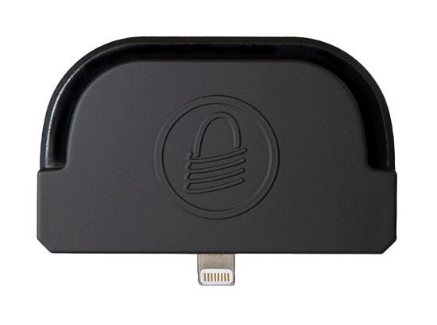
Magtek IDynamo 5
Connects directly to lightning host device Battery powered
Compatible with the Payarc mobile app
Payarc app available IOS devices only
Can do cash discount on both credit/debit cards Can do tips at the time of transaction only Cannot print receipts – Email receipts only Cannot do Auth and capture

Slide 11
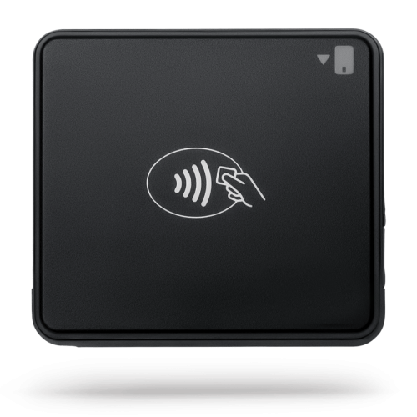
BBPOS Chipper
Bluetooth Connectivity only
Battery powered
Compatible with NMI’s iProcess app only
iProcess app available for Android and IOS devices Can do cash discount debit card only
Can do tips at the time of transaction only
Auto tax capability
Cannot print receipts – Email receipts only
Can do auth and capture

Slide 12
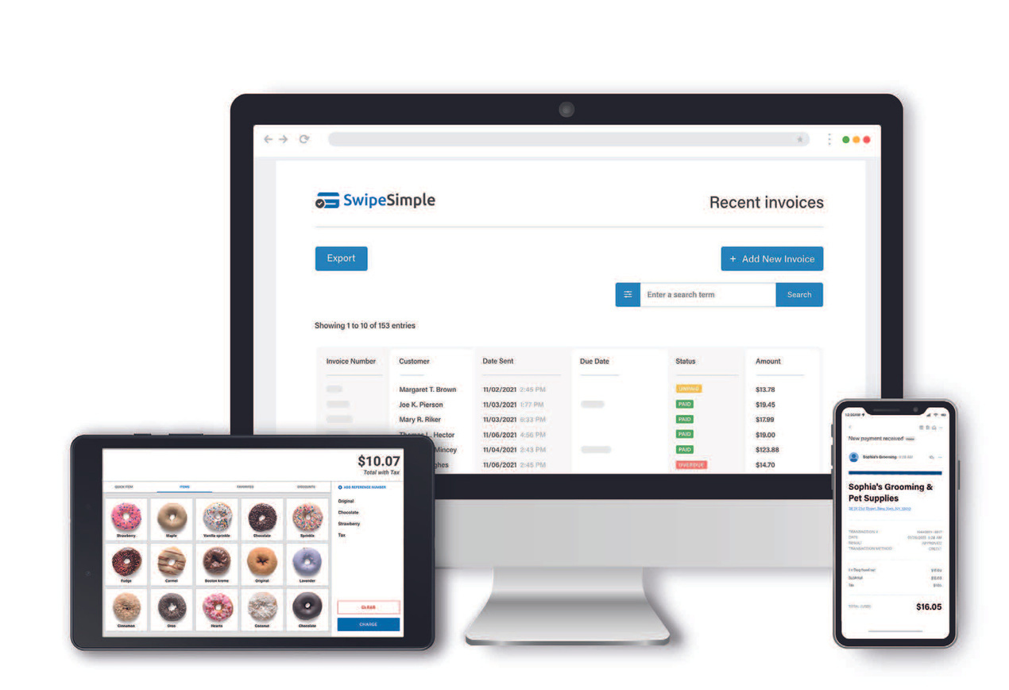
SwipeSimple
Accept credit cards online, invoice, and more Use on any iOS or Android device
Save customer cards and contact information Access reports, customer analytics, and more business tools
Recurring weekly, monthly, or annual
payments
Installment payments
Available Bluetooth card reader
Level II and III Interchange
Digital payment links for websites

Slide 13
Cash discount capability –credit/debit
Invoicing/recurring subscriptions Support integrations via API Email/text receipts
Reporting and analytics
Payarc Gateway
Accept online payments easily with our powerful payment platform for businesses of any size. Our virtual terminal allows merchants to successfully key in transactions with customizable features such as:
Cash discount capability Level II and III Processing
credit/debit Access statements
Invoicing/recurring subscriptions Dispute management
Support integrations via API Account branding
Email/text receipts Integrates with WooCommerce
Reporting and analytics and Magento (free of cost)

Slide 14


Product Matrix
Processing Method
Credit Sales
Pin Debit Sales
Cash Discount
Dual Pricing
EBT
Tax
Tips
EMV
Bluetooth
Pax - PAYARC App
Pax - Sierra App
Dejavoo QD Terminals
Dejavoo Z Terminals
Poynt Smart
NMI Iprocess App
PAYARC iOS App
SwipeSimple App
AMP Terminals
PAYARC Gateway
NMI Gateway
Authorize.net Gateway
USAePay Gateway

Slide 15
NMI
Key Features:
  Cash discount capability on credit only
  Invoicing/recurring subscriptions
  Supports integrations via the API and 3rd party plugins
  Email/text receipts
  Supports ACH processing
  Integrates with WooCommerce and Magento (additional fees may apply)

Slide 16
Authorize.net
Key Features:
  Does not support cash discount
  Invoicing/recurring subscriptions
  Supports integrations via the API and 3rd party plugins
  Email receipts
  Supports ACH processing
  WooCommerce integration (additional fees may apply)

Slide 17
USA ePay
Key Features:
  Does not support cash discount
  Invoicing/recurring subscriptions
  Supports integrations via the API
  Can do multicurrency through planet payments
  Supports ACH processing
  Integrates with WooCommerce and Magento (additional fees may apply)

Slide 18
SwipeSimple
Key Features:
  Any iOS or Android device can be a point-of-sale system. Log in instantly
  on any phone, tablet, or computer and accept payments.
  Take payments wherever the customers are. No other hardware is needed.
  Set up recurring payments, and invoices, or let customers pay in installments.
  Option to accept physical credit and debit cards with the SwipeSimple
  Bluetooth card reader.
  Every account comes with a reporting dashboard with tools and insights.

Slide 19
Agent Buy Rates
Brand
Terminal
Cost
Injection
Total Cost
Brand
Terminal
Cost
Injection
Total Cost
PAX
A80
$215.00
$10.00
$225.00
Z8
Dejavoo
$195.00
$10.00
$205.00
PAX
A920
$330.00
$10.00
$340.00
Z9
Dejavoo
$336.00
$10.00
$346.00
PAX
A920 Pro
$340.00
$10.00
$350.00
Z11
Dejavoo
$232.00
$10.00
$242.00
PAX
SP20
$79.20
$10.00
$89.20
QD4
Dejavoo
$276.00
$10.00
$286.00
PAX
SP30
$205.00
$10.00
$215.00
QD2
Dejavoo
$330.00
$10.00
$340.00
PAX
S300
$220.00
$10.00
$230.00
QD5 Pinpad
Dejavoo
$253.00
$10.00
$263.00
PAX
A35
$290.00
$10.00
$300.00
Z6 Pinpad
Dejavoo
$213.00
$10.00
$223.00
PAX
A920 Docking Station
$95.70
$0.00
$95.70
Z3 Pinpad
Dejavoo
$167.00
$10.00
$177.00

Slide 20


Thank You!

